Slide 1




Data-Limited Fisheries Toolkit
Evaluating management strategies for data-limited fish species
Custom output control MPs
Lecture 4b, Nov 22nd 2017
Tom Carruthers & Adrian Hordyk .

Slide 2
Agenda
The format of DLMtool simulated data
A simple output MP
A more complex output MP
Tips for MP design

Slide 3
The format of DLMtool simulated data
Exactly the same as the real data!
However:
Parameters are now vectors nsim long
Time varying data (e.g. historical annual catches) are a matrix nsim rows by nyears.

Slide 4
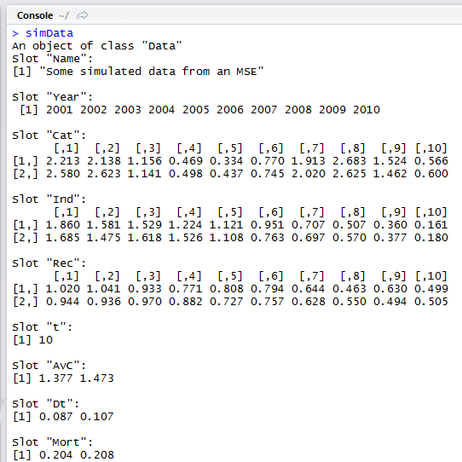
Year constant
Catch by sim
Rel. Abun index by sim
Recruit. Index by sim
Duration of AvC constant
Average Catch by sim
Depln. Over t by sim
Natural Mortality by sim

Slide 5
MP design
All DLMtool output MPs are functions that look like this:
myMP = function(x, Data, reps){
< some code working on position x of Data that
returns a TAC >
}
For example, an ‘half average catch’ MP (TAC is half of average historical catches): would be:
HAC = function(x, Data, reps){
0.5*mean(Data@Cat[x, ])
}

Slide 6
MP design 2
Our half average Cat MP
HAC = function(x, Data, reps){
0.5*mean(Data@Cat[x, ])
}
does not provide stochastic TAC recommendations. We could add uncertainty that is equal to the standard error:
HAC = function(x, Data, reps){
muCat = 0.5*mean(Data@Cat[x, ])
nyears = length(Data@Cat[x, ])
StErr = Data@CV_Cat[x] / nyears^0.5
rnorm(reps, muCat, StErr)
}

Slide 7
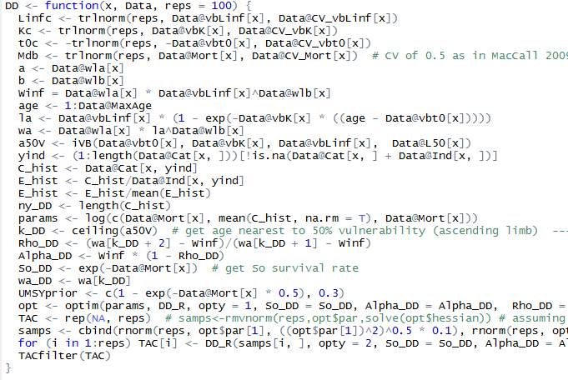
MP design 3: anything goes

Slide 8
MP design 3: anything goes

Slide 9
One thing left to do:
- We have to assign the right class to our new MP:
class(HAC) = “Output”
Now HAC will be detected by Can(), Cant(), Needed() and can be used to both set TACs with real data using TAC() and Sense() and also be tested in runMSE().

Slide 10
Three things left to do:
- We have to assign the right class to our new MP:
class(HAC) = “Output”
- It has to be visible to DLMtool:
environment(HAC) = asNamespace(“DLMtool”)
- And it should be compatible with parallel processing:
sfExport(“HAC”)
Now HAC will be detected by Can(), Cant(), Needed() and can be used to both set TACs with real data using TAC() and Sense() and also be tested in runMSE().

Slide 11
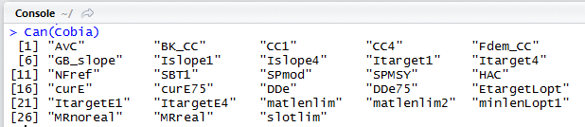
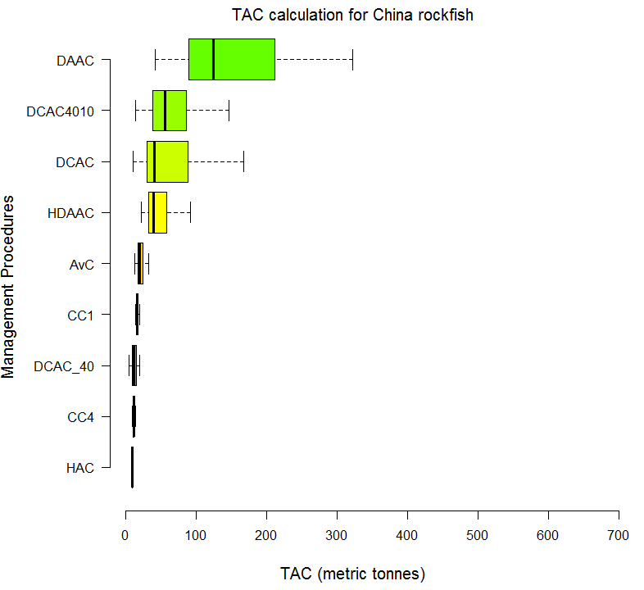
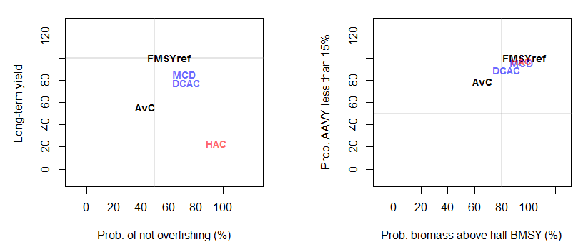

Slide 12
Tips for MP design
Make them robust. For example, make sure they do not return NA values
Make them fast. I.e. less than 1-2 seconds per run of the MP
Make them specific. We already have complex frameworks where lots of data are available, MPs can occupy a niche (e.g. a life-history type and data type)
Allow them to have tunable parameters (e.g. speed of change, duration for smoothing data etc) so others can adapt them
Document them
Make them public.

Slide 13
Handy commands
Available MPs: avail(‘Output’)
R help: ?DCAC
The full code: DCAC

